Slide 1
Data Analytics - Accuracy Lesson 2
Jeffrey Strickland, Ph.D.
“Know what can be fixed and what cannot, and distinguish between the two. Then only work on the problems you can fix—a day of pontificating theory is a day of lost work.”
—Dr. Jeffrey Strickland, Senior Data Scientist

Slide 2



Data Quality
A harmonized Information requirement
Mutual understanding of data capability
Trustworthy and credible information
Consistent
Relevant
Accurate
Timely
Transparent
Completeness
Precise
Completeness
Accurate
Consistent
I agree!
Data Quality
Timely
Relevant
Precise
Transparent
Notes:
angat janakari ki avashyakata
data kshamata apasi samajh
hunuparch&vishvasaniy suuchana

Slide 3

Data Accuracy
Good fit between data and reality
The ability to draw correct conclusions from data
Business processes that match reality
Data accuracy is measured as the reciprocal maximum gap between data and reality (high is good)
$$Data Accuracy=\frac{Data entered in DB}{Reality}$$
Data Quality
Completeness
Consistent
Relevant
Transparent
Precise
Timely
Accurate
Data Quality like Reliability is a product of its parts. parts contribute zero to the total.”
—Dr. Jeffrey Strickland, Senior Data Scientist

Slide 4
Data Accuracy Examples
For member X, an incident Y is reported as $2.30K when it was really $23.0K
𝐷𝑎𝑡𝑎 𝐴𝑐𝑐𝑢𝑟𝑎𝑐𝑦=(Amt Entered,$2.3K)/(Actual Amt,$23K) = 2.3/23 = 10%
A homeowner flag appears as “homeowner” when it is really “renter”
A member’s entry for number of kids between ages 16-and 21 (household) is entered as 1, but the reality is 3
𝐷𝑎𝑡𝑎 𝐴𝑐𝑐𝑢𝑟𝑎𝑐𝑦=1/3=0.33%
“Don’t try to check data accuracy if the member is engaged in combat with the Taliban and his unit is in an exposed position, running low and ammo, and the unit’s radio has become a casualty. Otherwise check.”
—Jeffrey Strickland, Retired Military Member

Slide 5
Data Timeliness
Data that is available without delay
Ability to know what is needed, when it is needed
Smooth information flow: Data Delayed” is “data Denied.”
Data Timeliness is measured as the percentage of processing time attributed to waiting for data (0.0% is bets)
Strickland’s Data Timeliness Principle: Data is timely as long you have time to wait.
Data Quality
Completeness
Consistent
Relevant
Transparent
Precise
Timely
Accurate
$$Data Timeliness=\frac{processing time attributed to waiting for data}{data request processing}$$

Slide 6
Data Timeliness Examples
A request for Life Web Interest data had a Data Timeliness metric over 60%
𝐷𝑎𝑡𝑎 𝑇𝑖𝑚𝑒𝑙𝑖𝑛𝑒𝑠𝑠 Data Timeliness(Data Table 1𝑎)=30 days/45 days =0.6667 𝑜𝑟 66.67%
A request for Home Owner data had a Data Timeliness metric over 90%%
𝐷𝑎𝑡𝑎 𝑇𝑖𝑚𝑒𝑙𝑖𝑛𝑒𝑠𝑠 Data Timeliness(Data Table 2𝑎)=330/360=0.9167 𝑜𝑟 91.67%
"Organizations get overwhelmed quickly when you talk about data quality. It's a journey, a way of doing business that's going to change things, and it needs to be maintained," said Angela Fernandez, VP of retail grocery and food service at information standards organization GS1 US.
—Moshe Kranc, CTO of Ness Software Engineering Services

Slide 7
Data Precision
A close fit between the desired information and available information
The ability to pinpoint decisions based on data
Data precision metric
The reciprocal maximum distance between all applicable data interpretations
The minimum delta between the desired information and all available interpretations
Data Quality
Completeness
Consistent
Relevant
Transparent
Precise
Timely
Accurate
“Whenever I see a forecast written out to two decimal places, I cannot help but wonder if there is a misunderstanding of the limitations of the data, and an illusion of precision.”
—Barry Ritholtz, Author of Bailout Nation

Slide 8
Data Precision Example
Suppose we are collecting data on member satisfaction with auto premiums (satisfied or unsatisfied)
Do all of these precision errors provide the precise interpretation of the response?
An error in precision: the billing incident was caused by an error in premium calculation—possibly frustration
An error in education: the billing incident was caused by a misunderstanding of the premium calculation—possibly
An error in perception/fairness: response was due to dissatisfaction with a prior MSR call
NASA’s Ares I required a precise 4-day window for a moon shot. We modeled it with simulation and then built the damn thing to match the sim data. The first test launch was a complete success.
—Dr. Jeffrey Strickland, Rocket Scientist

Slide 9
Data Transparency
Ability to easily access and work with data
no matter where they are located
no matter what application created them
balancing data/information security requirements
Assurance that data being reported are accurate and are coming from the official source.
Data Quality
Completeness
Consistent
Relevant
Transparent
Precise
Timely
Accurate
“The antagonist muscle for arm flexion is the triceps brachii muscle. The antagonist for data access is the information security ‘muscle.’”
—Dr. Jeffrey Strickland, Senior Data Scientist

Slide 10
Data Transparency Example
We can tell why midsize sedan is now midsize crossover in the DB
In a data field with a normal range from 2 to 5, there is an unexplained entry of 9
Does a green rating for one field record mean the same as a green rating for a different record in the same field?
The “flag” for new mortgage and refi in Core Logic is trustworthy?
“Often, the best data is the dirtiest data.”
—Jeffrey Strickland, Data Scientist

Slide 11
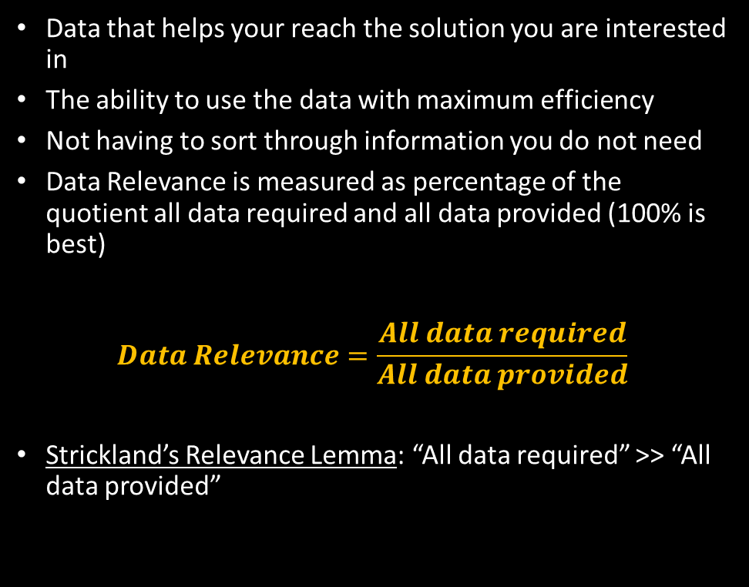
Data Relevancy
Data that helps your reach the solution you are interested in
The ability to use the data with maximum efficiency
Not having to sort through information you do not need
Data Relevance is measured as percentage of the quotient all data required and all data provided (100% is best)
$$Data Relevance=\frac{All data required}{All data provided}$$
Strickland’s Relevance Lemma: “All data required” >> “All data provided”
Data Quality
Completeness
Consistent
Relevant
Transparent
Precise
Timely
Accurate

Slide 12
Data Relevance Example
A member calls a MSR over the amount of an auto premium
Are all of these MSR questions relevance or have the same degree or relevancy?
A MSR asks a member if they are a homeowner
A MSR asks a member if they own a new or used car
A MSR asks a if they would be open to taking a Defensive Driver Education Course

Slide 13

Data Consistency
Trustworthy data in the entire data supply chain
The ability to connect data with its real meaning
Real accountability for data objects
Data consistency is measured as the quotient (percentage) of the maximum traceable distance and the total processing steps
Strickland’s Consistency Principle: Data is always consistent when Saturn, Mars, and Earth are aligned with the Sun. It is a quantum effect.
Data Quality
Completeness
Consistent
Relevant
Transparent
Precise
Timely
Accurate
$$Data Consistency=\frac{maximum traceable distance}{total processing steps}$$

Slide 14
Data Consistency Examples
We can tell why midsize sedan is now midsize crossover in the DB
In a data field with a normal range from 2 to 5, there is an unexplained entry of 9
Does a green rating for one field record mean the same as a green rating for a different record in the same field?
The “flag” for new mortgage and refi in Core Logic is trustworthy?

Slide 15

Data Completeness
Does the data not leave any open questions
The ability to make good decisions based on the data
Closeness between “need to know” and what the data tells you
Data completeness is measured as a percentage the quotient of data available and the data required (100% is pest).
Data Quality
Completeness
Consistent
Relevant
Transparent
Precise
Timely
Accurate
$$Data Completeness=\frac{Data available}{Data required}$$
“On the day I had complete data, Ed McMahon sent me a check for $23K—it bounced.
—Dr. Jeffrey Strickland, Senior Data Scientist

Slide 16
Data Completeness Examples
For some of the most important variables available (measured by information value), the data completeness metric lies below 50%
Suppose we are interested in identifying member who need an auto policy or needs to add to an existing policy
Number of children between 16 & 21 in the household: data completeness < X%
Number of automobiles owned by the member: data completeness < 50%
Average miles driven annually per vehicle : data completeness < 50%

Slide 17
Solutions
Data mapping is the process of creating data element mappings between two distinct data models. Data mapping is used as a first step for a wide variety of data integration tasks including: Data transformation or data mediation between a data source and a destination: consistency, accuracy, timeliness, transparency
Information Value Theory—precision, relevance
Data verification is a process in which different types of data are checked for accuracy and inconsistencies after data migration is done. It helps to determine whether data was accurately translated when data is transferred from one source to another, is complete, and supports processes in the new system—accuracy, completeness, consistency, transparency
Data validation is the process of ensuring that data have undergone data cleansing to ensure they have data quality, that is, that they are both correct and useful—accuracy/correctness, relevancy
Master Data – All data having attributes referring to Reference Data in the organization may be validated against the set of well-defined valid values of Reference Data to discover new or discrepant values through the validity DQ check. Results may be used to update Reference Data administered under Master Data Management (MDM).
Matching or Linking – a way to compare data so that similar, but slightly different records can be aligned. Matching may use "fuzzy logic" to find duplicates in the data. It often recognizes that "Bob" and "Robert" may be the same individual. It might be able to manage "householding", or finding links between spouses at the same address, for example. Finally, it often can build a "best of breed" record, taking the best components from multiple data sources and building a single super-record

Slide 18
Solutions
Employ all Optimal Solutions that are Feasible: "People think data accuracy is 100% accurate. We're dealing with tens of millions of pieces of content a month, so it's hard to get to 100% accuracy," said James O'Malley, senior VP of analytics at communications agency Porter Novelli. "The cost to achieve an incremental increase in accuracy doesn't necessarily benefit the decision-making process. Improving accuracy from 98% to 99% can involve far more cost and time than is practical, particularly if the difference would not affect the business outcome.“
Use Source Data (only): "Data quality means having data in a format you can trust. One of the biggest challenges is figuring out the golden source of data. Data gets copied from source to source. Before you know it, all the people who worked on all of those projects have been fired, and no one is really sure where the data comes from," said Moshe Kranc, CTO of Ness Software Engineering Services. "I've seen business analysts spend months analyzing [the wrong] data source because they thought it was the golden data source.”
Human Computing Machine: Ensemble models combine multiple models of the same type of different types (usually machine learning algorithms) to draw out the strengths of each model while minimizing the weaknesses. Ted Greenwald, writing for the Wall Street Journal, 29 April 2018, says” “She's smart, a master of high-end design software. She's kind, ready to help at any time of day or night. She's the new AVA - an acronym for automated virtual assistant - a next-generation digital assistant created by Autodesk Inc. to help its customers with its software. She's scheduled to replace the company's current text-only chatbot that goes by the same name in mid-May.” This human computing machine by Soul Machines improve the member experience and captures the data output from a conversation.
Simulation: Data quality encompasses all its characteristics and we often fail to achieve it in completeness. In Data Science for Ordinary People (2nd Edition), author Jeffrey Strickland says, “Simulation is a great way to complete your data. It is not fantasy, where perhaps we generate missing data by generating a new Orc or Elf, but a scientific method of generating data from the probability distributions associated with the fields we wish to fill. People who are the same age as I am and who share other characteristics such as use of technology, propensity to take particular actions, etc., are more likely to perform the same kind of online transactions using the same modes.”

Slide 19
Data Quality Examples
Suppose all of our data quality metrics are 95%, except data completeness, which is 75%. Then
Data Quality = PRODUCT(95%,95%,95%,95%,95%,75%) = 51%
Suppose we can complete the missing data using simulation.
Data Quality = PRODUCT(95%,95%,95%,95%,95%,100%) = 74%
“74% is close enough in hand grenades and enterprise modeling.”
—Dr. Jeffrey Strickland, Senior Data Scientist

